Slide 1
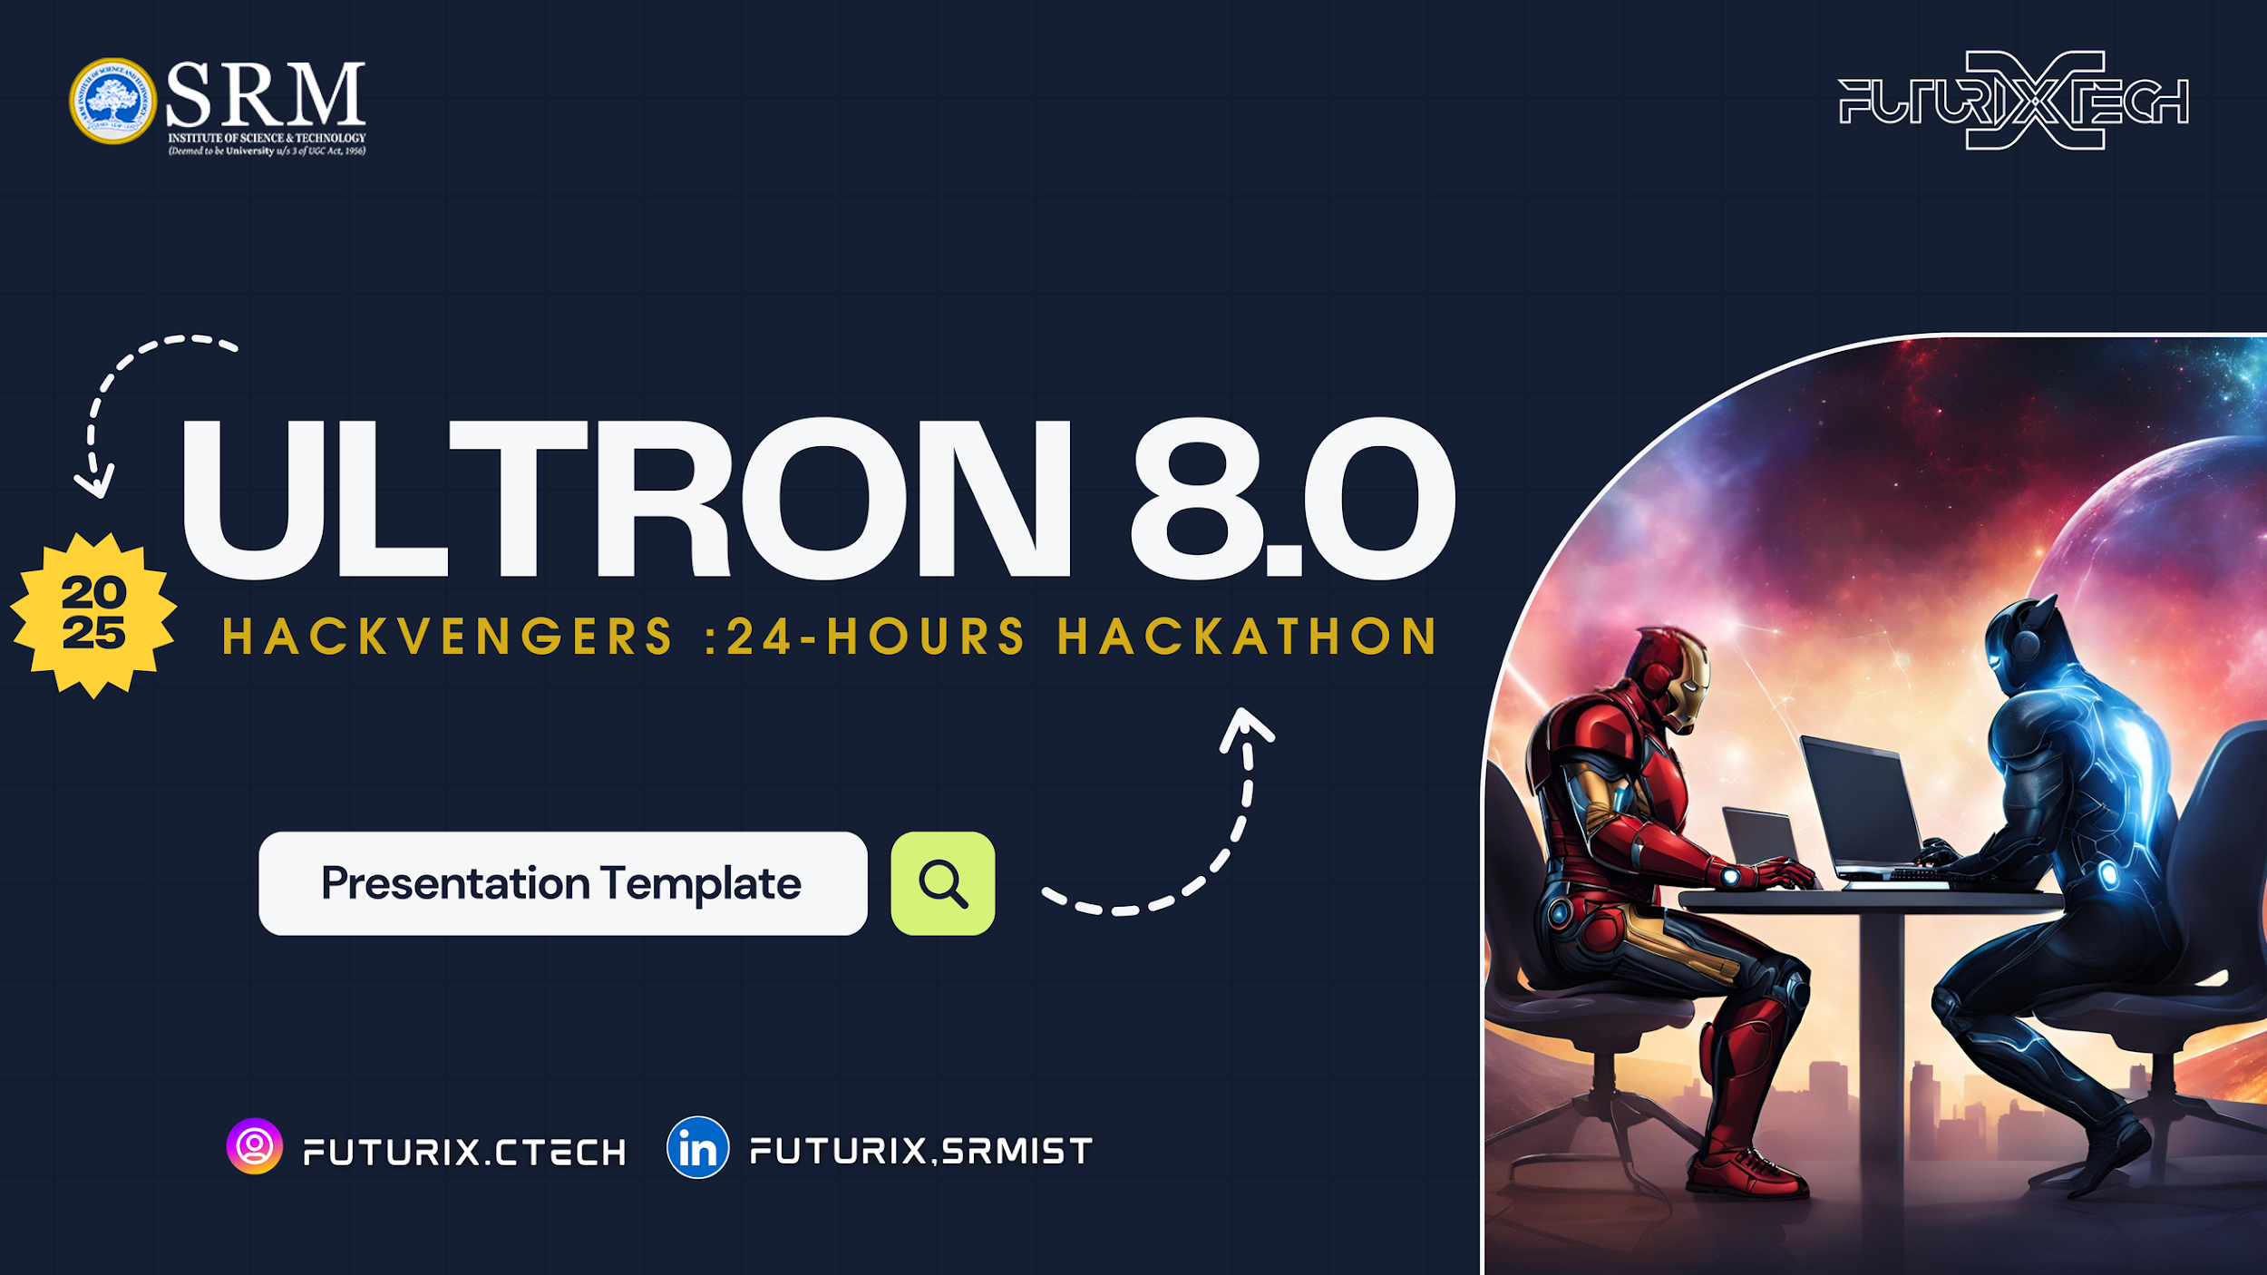

Slide 2



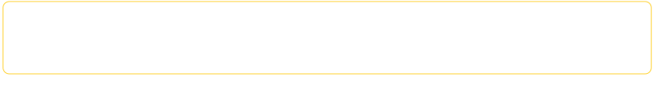
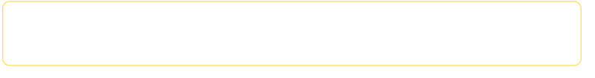
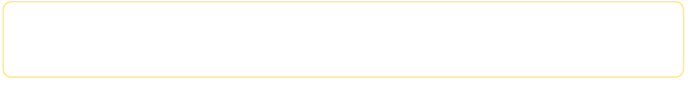
INTRODUCTION
PROJECT NAME :
MultiplyMinds : Learn Math through game
TEAM LEAD :
Rishav Goswami
TEAM NAME :
Ember Wing
TRACK :
GameTech

Slide 3



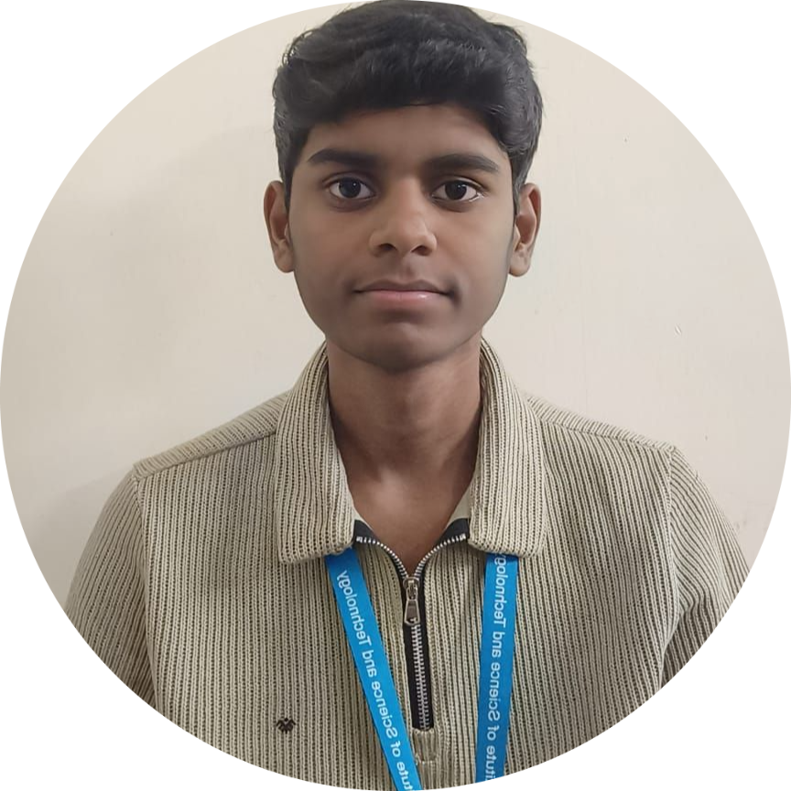



TEAM MEMBERS
Name:
Rishav Goswami
Role :
GameDev
Digital artist
Name:
Manideeph Hanumanthu
Role :
PPT designer
Name:
Vamsi Krishna Yachamaneni
Role :
UI designer
Name:
Jashwanth Ankadi
Role :
Music artist
Name:
Syed Rayhaan
Role :
PPT designer

Slide 4


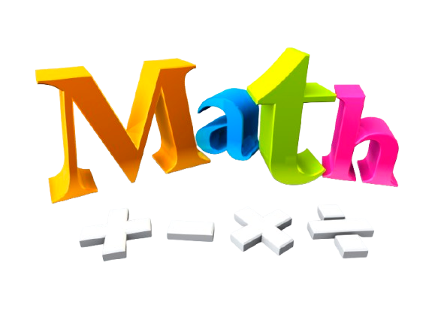

PROBLEM STATEMENT
Most children in our current generation is playing games all day long and not inclined towards studying.
Therefore, to make learning fun for them, how about we make a game such that they are engaged to learning and enjoy themselves at the same time.
This way, the children will improve their mind through gaming.

Slide 5



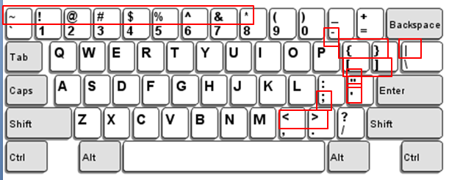
IDEA OR PROPOSED SOLUTION
Briefly Explain Your Idea
The idea is to make a game that implements a math based combat system.
The players will have to solve simple math problems in a flash to meet the requirement of the goalNum.
The player has to press a number on the keyboard such that when the operation is done, the result is goal.
Eg.
If goalNum is 6 and bossNum is 3
If the operation is multiplication, then
you have to figure out which number when multiplied will result in goalNum(6)
Therefore, player has to press 3 and press spacebar to launch attack on boss

Slide 6


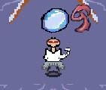
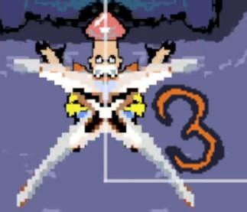

IDEA OR PROPOSED SOLUTION
How does it solve the problem ?
It solves the problem since it improves the mind of the player playing it.
The game we developed helps the children learn the basic operations of :
Addition (x + y = goalNum)
Subtraction (x - y = goalNum)
Multiplication (x * y = goalNum)
Division (x / y = goalNum)
playerNum(x)
bossNum (y)
goalNum

Slide 7

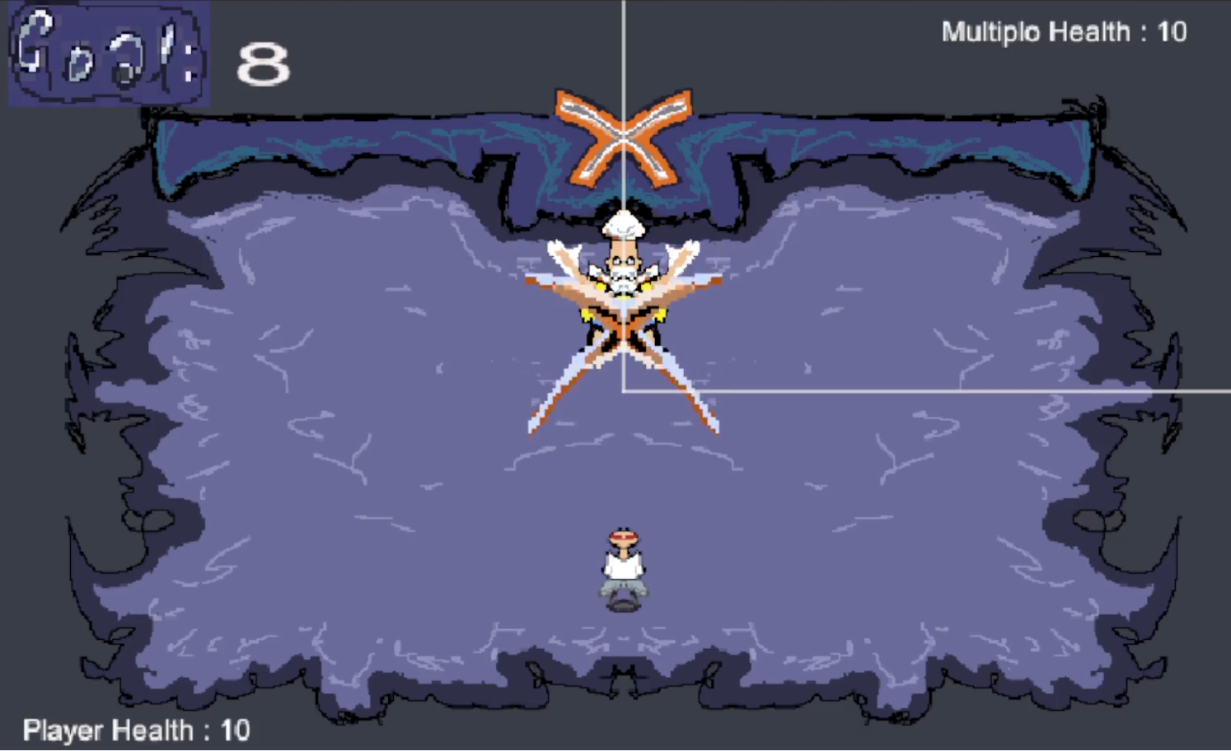




IDEA OR PROPOSED SOLUTION
Highlight the innovative aspects.
This theory is simple. The player has to figure out which number to add, subtract, multiply or divide with to get the goalNum.
The player attacks with his sphere.
The boss attacks with its signature move

Slide 8





TECHNICAL APPROACH
Tech - Stack Used
Unity Engine
Blender
LibreSprite
Visual Studio Code C#

Slide 9
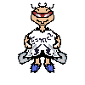
TECHNICAL APPROACH
Flowchart / Architecture Diagram
x + y
x
x - y
y
x * y
Here :-
x : BossNum
y : PlayerNum
Goal : Required number to reach
x / y

Slide 10



FEASIBILITY & SCALABILITY
This game will be available in the following platforms:
Web
Desktop
Mobile
The feasibility of this game can be implemented in many ways.
There are plenty of games that involve around education and this game we made is to delve into learning to do basic math operations through playing this game.

Slide 11

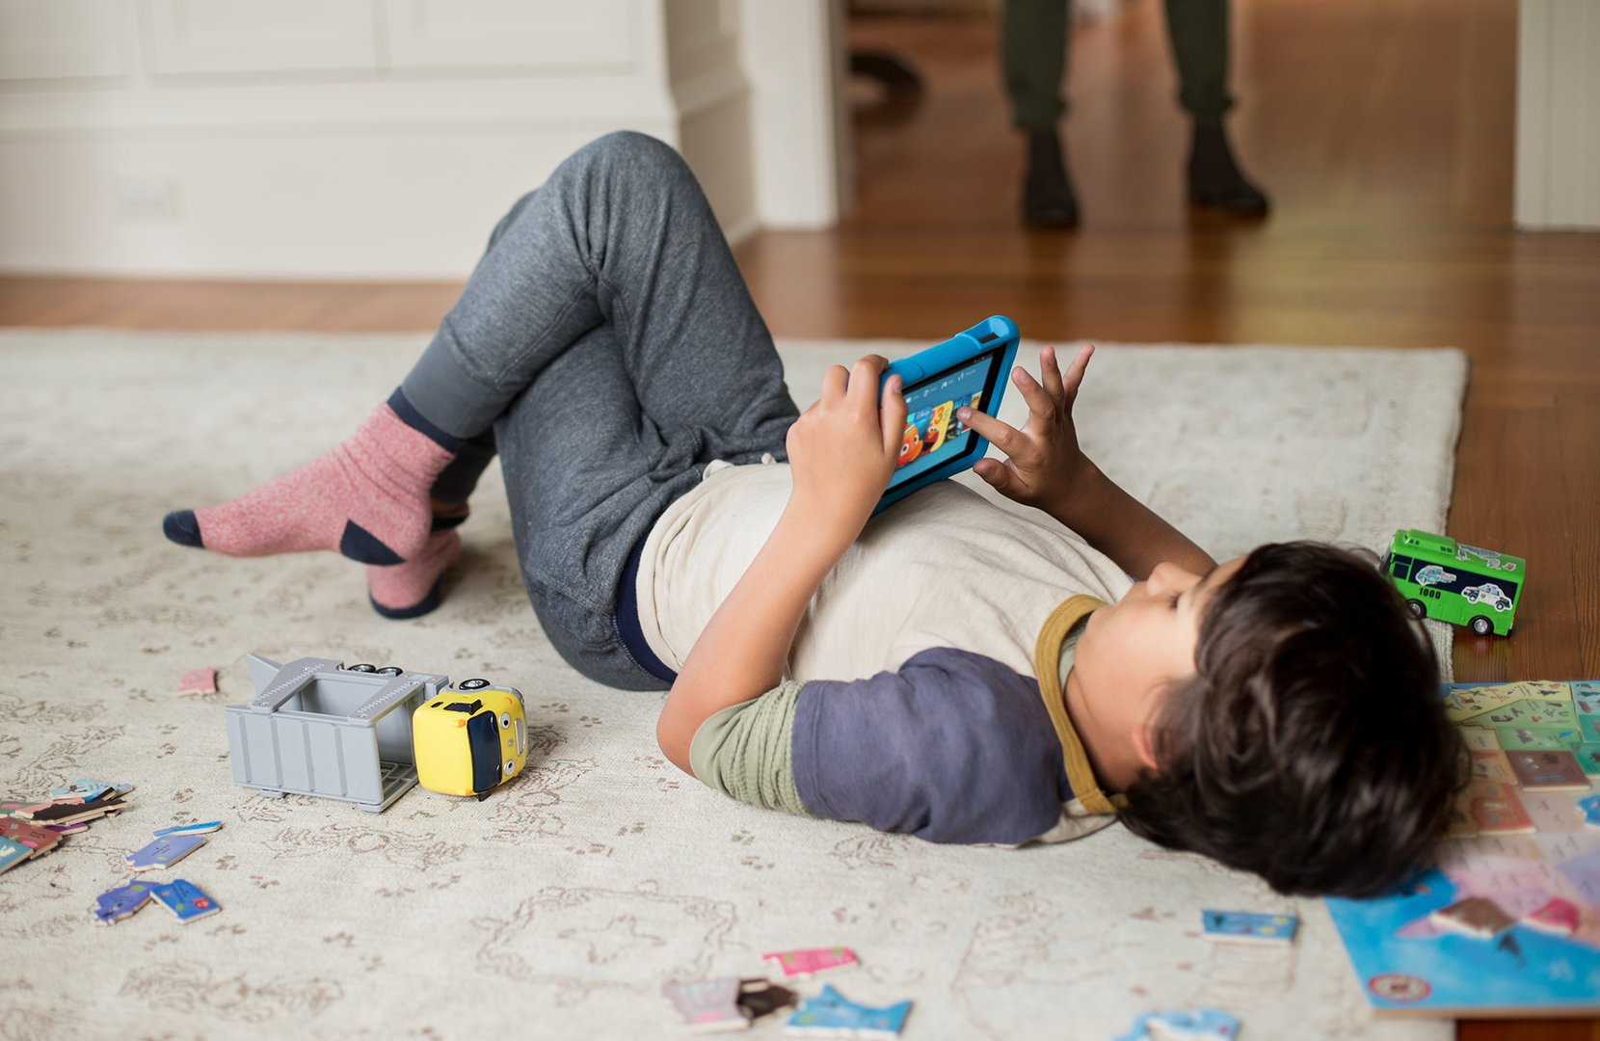
IMPACT AND BENEFITS
The children will learn to play and have fun with numbers.
The purpose of this project is to upskill children’s mind and help them get back into studying math.
Studying can be boring at times but our idea is to explore a unique way of learning.
And that is through playing games.
If learning can be fun, then the children of new generation will be very much benefited.

Slide 12


THANK YOU
Website :
Phone Number :
Social Media :
Email Address :
ultron8.vercel.app
7200760948
futurix.ctech
futurix.ctech@gmail.com

